Slide 1

Welcome to POL 101
Dr. Hasan Muhammad Baniamin

Slide 2
Course philosophy
Not to memorize but to develop critical thinking ability and learning attitudes

Slide 3
Your thinking process
Who resemble you the most in terms of thinking?
  Preacher,
  Politician,
  Prosecutor, or
  Scientist

Slide 4
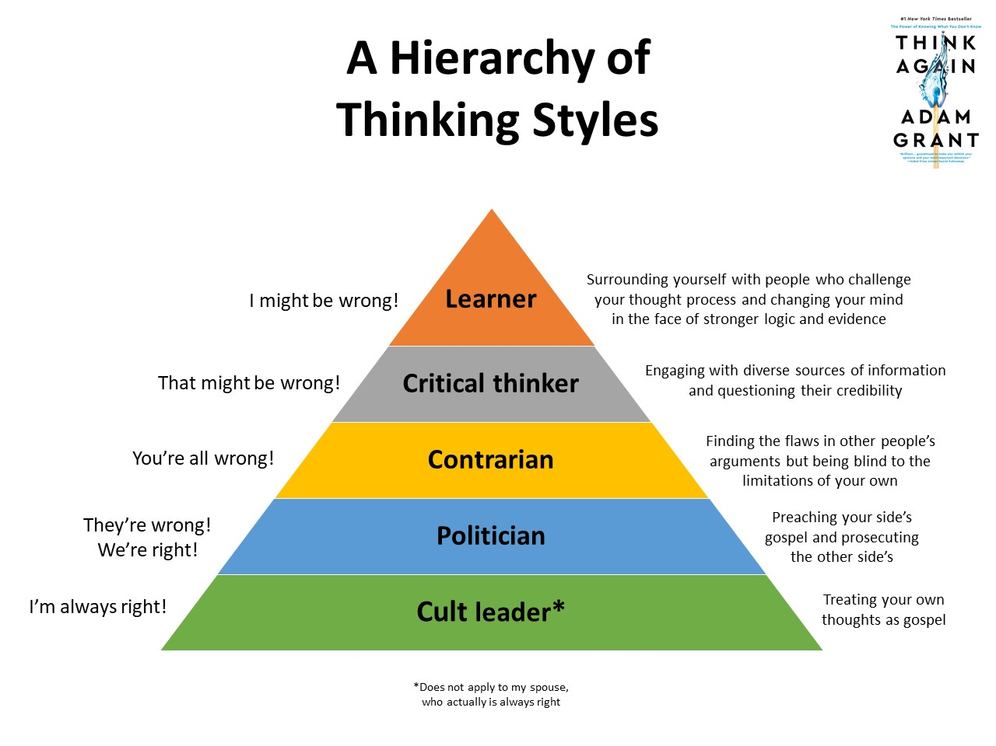

Slide 5
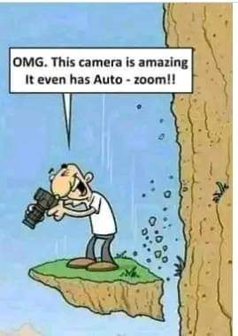

Slide 6
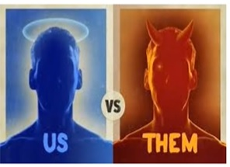

Slide 7
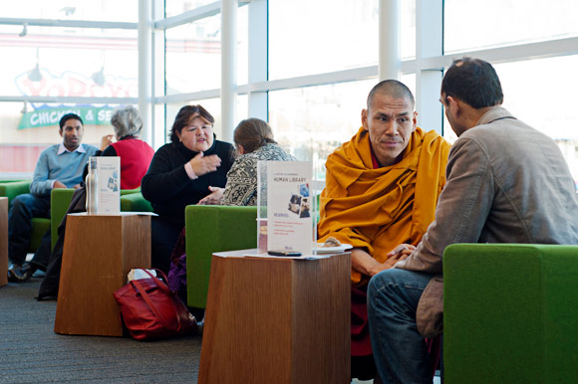

Resources for the course-Human Library & Taken from Life
Human Library

Slide 8
Question style
Do you know what climate change is?
What are three causes of climate change?
Why do some claim that climate change is the biggest crisis?

Slide 9
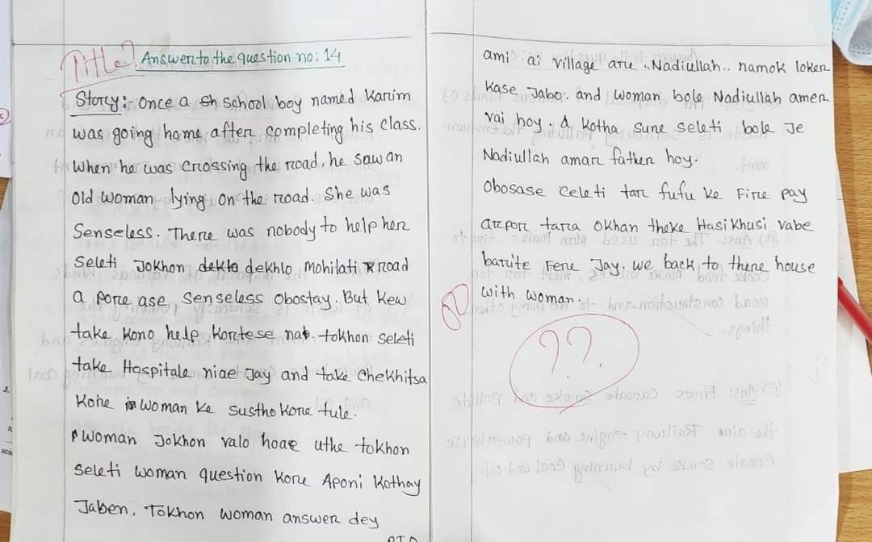

Slide 10
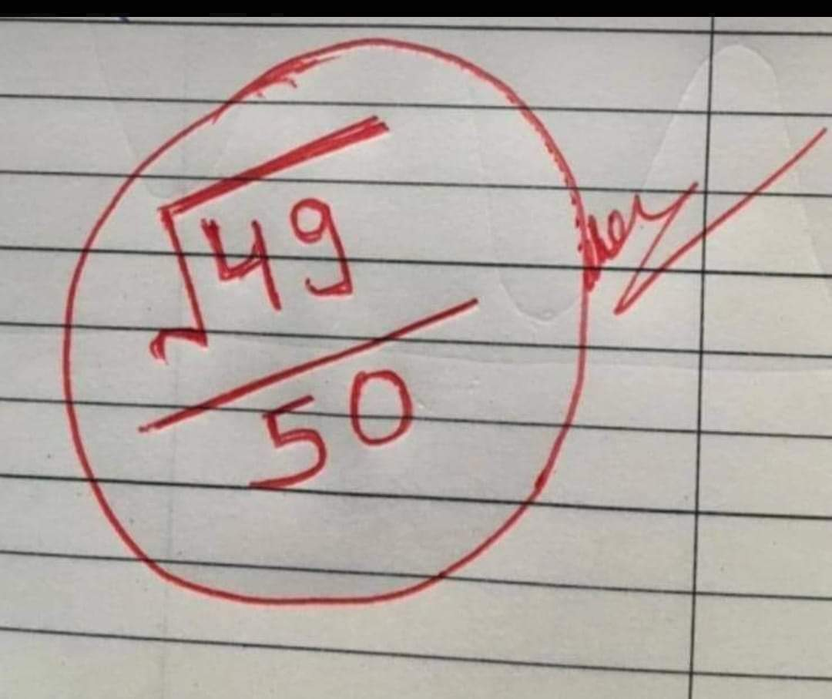

Slide 11
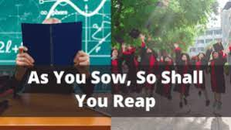

Slide 12
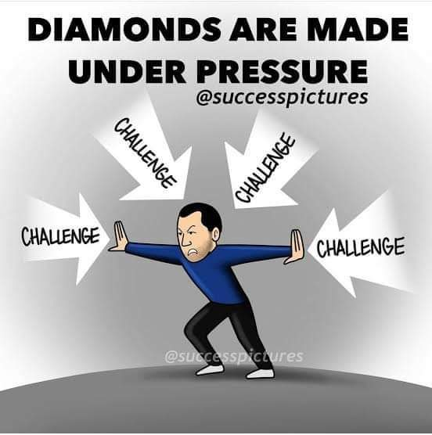

Slide 13
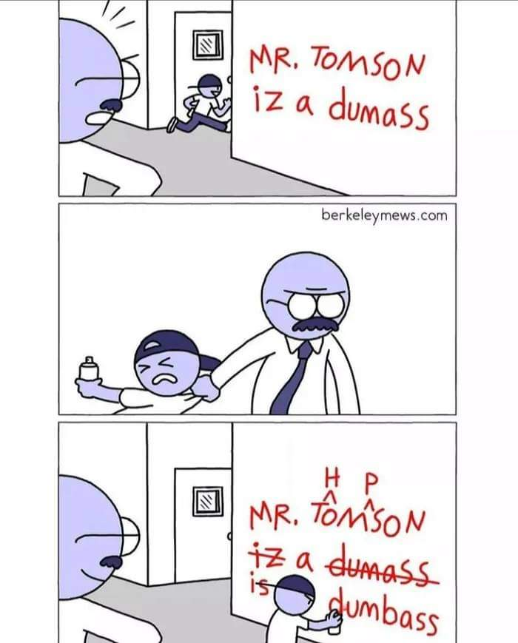

Slide 14
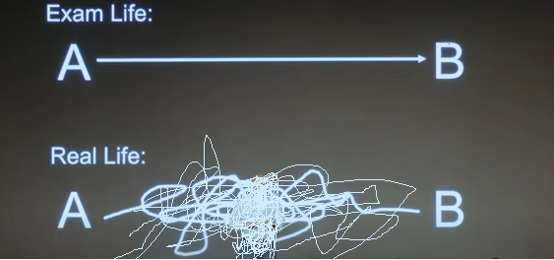
Exam life vs. real life

Slide 15
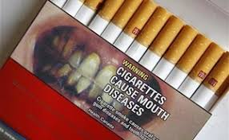

Slide 16
​The data is the new oil

Slide 17
People’s behaviour
$20 $5 25%
$2000 $500 25%

Slide 18
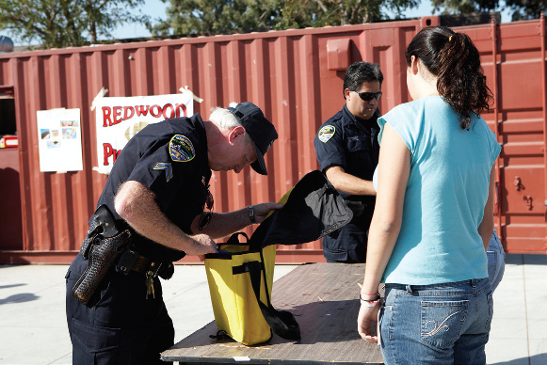
What do you think about this picture?

Slide 19
Q?

